Slide 1
Intro to Reverse Engineering
By: Noah Dunn

Slide 2
What Is Reverse Engineering?
In standard Engineering disciplines, Reverse Engineering is when in order to better understand a particular design, an engineer dissects it into various pieces and understands what each piece does.
In Computer Science, the same is done, except by taking an executable program (often referred to as a binary), and tearing it apart in order to determine what its functionality is.

Slide 3
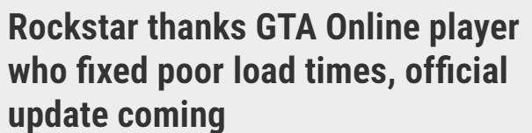
Practical Benefits of Software Reverse Engineering
Obtaining Bug Bounties
Game Hacking
Digital Forensics
Testing Application Based Software
Malware Analysis
Reverse Engineering GTA Source Code nets a player 20k for a 20 line fix Technical Analysis and The Story

Slide 4
Disassembler, Decompiler, Debugger
Disassembler - Transforms an executable into Assembly Code
Debugger - Allows the changing and viewing of program state
Decompiler - Transforms a binary file into a higher level language like C
Linear - Code is displayed as it appears, no graphical representation
Graph - Code is displayed in a visual representation. Control flow is (subjectively) easier to understand
https://reverseengineering.stackexchange.com/questions/4635/whats-the-difference-between-a-disassembler-debugger-and-decompiler

Slide 5



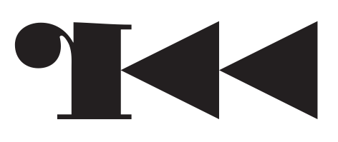

Tools of the Trade
IDA/IDA PRO - Arguably the best, the paid version is >3k for a license
Ghidra - Developed by the NSA, Good and Free
BinaryNinja - Decompiler only, offers Linear and Graph views. Has a cloud implementation
R2 (Radare2) - Complete framework that is command line only
Cutter - R2 with a GUI

Slide 6
Good Resources - Digital
TryHackMe
HackTheBox
Malware Unicorn
CyberQueens
Awesome Reversing
Reverse Engineering Repo

Slide 7
Good Resources - Print
Practical Malware Analysis - No Starch Press
Reversing: Secrets of Reverse Engineering - Wiley
The IDA Pro Book - No Starch Press
Practical Reverse Engineering - Wiley
The Ghidra Book - No Starch Press

Slide 8
Example Exercise: Magic Letter
This is a sample reversing exercise intended for high school students, but this should not put off the casual observer. While some may find it very easy, these exercises can be quite difficult to those not accustomed to using the tooling or solving these kind of problems
Available Here: MagicLetter

